Slide 1
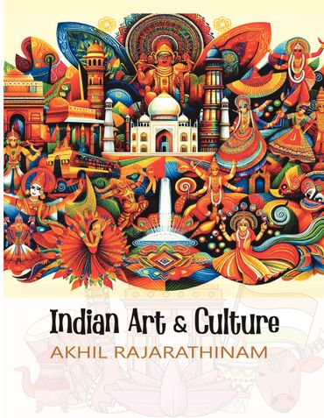
ARTS AND CULTURE

Slide 2
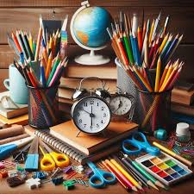
ART
Art means various branches of creative activity, such as painting, music, literature, and dance

Slide 3
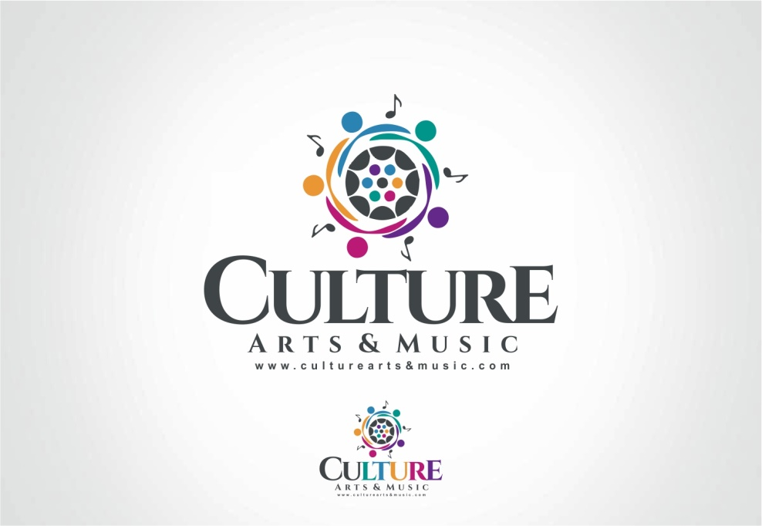
CULTURE
The ideas, customs, and social behavior of a particular people or society.

Slide 4
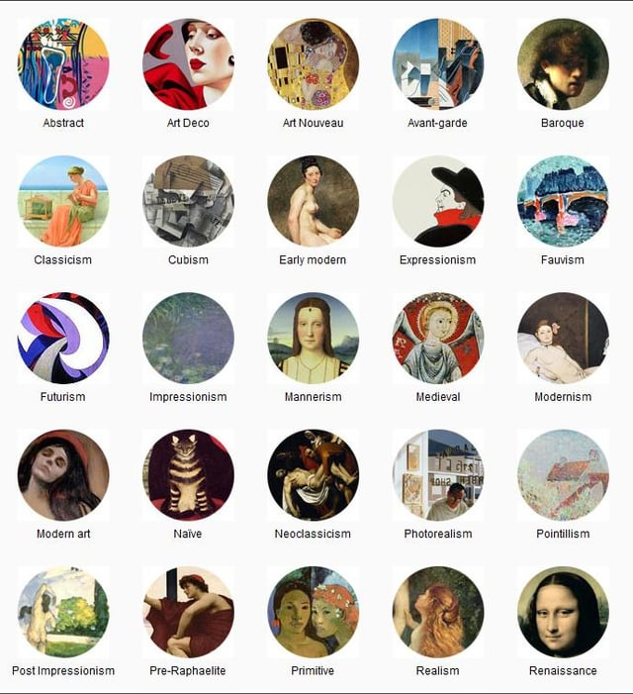
TYPES OF ARTS
Art has too many types, some of them are:
. Visual Art
. Performing Arts
. Digital Art
. Primitive Art

Slide 5
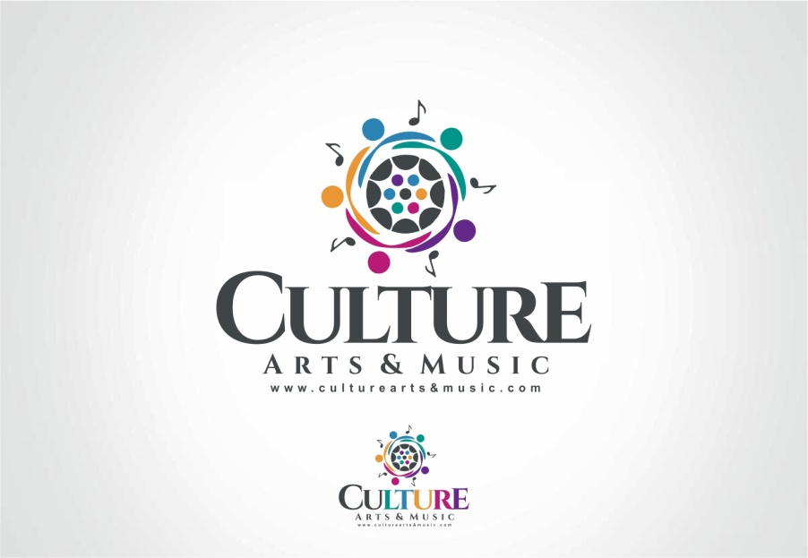
TYPES OF CULTURE
Consumer Culture
High Context Culture
Low Context Culture
Remix Culture
Participatory Culture

Slide 6
SIMILARITY BETWEEN ARTS AND CULTURE
Art is a subtype of culture
Every culture promotes art
Every culture has a specific type of arts in different forms like craft, dance, calligraphy etc.

Slide 7
COUNTRIES WITH RICH ART AND CULTURE
Pakistan
India
Afghanistan
Iran
Turkey
Bangladesh
Sri Lanka
Thailand
UAE

Slide 8
IMPORTANCE
Most simple terms is communication.
Medium to express ideas and to share information.
Art highlights the beauty of culture.

Slide 9

Thank you

